Slide 1


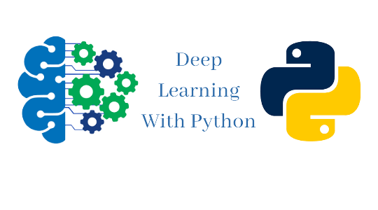


ISCG8050 Machine Learning for Intelligent Data and Information Processing
Week 3 - B
Sources: Hands-On Machine Learning with Scikit-Learn, Keras, and TensorFlow by Aurélien Géron

Slide 2
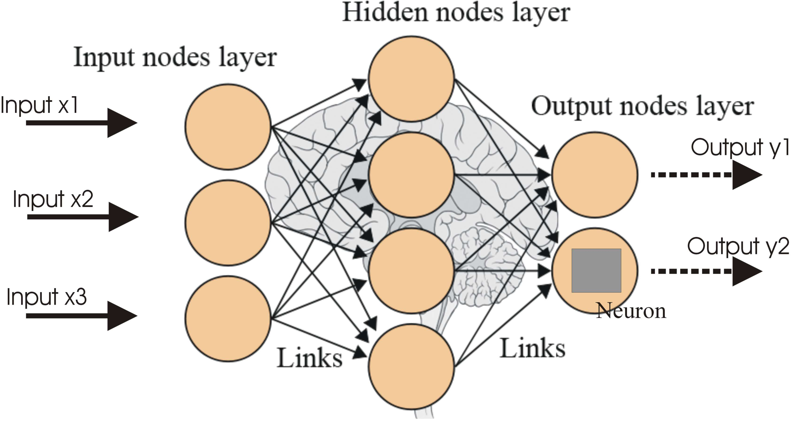
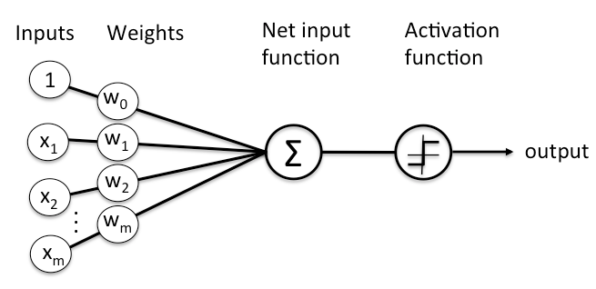
Review
Neural networks are a set of algorithms, modelled loosely after the human brain, and are designed to recognize patterns.
The patterns they recognize are numerical, contained in vectors, into which all real-world data, be it images, sound, text or time series, must be translated.
Networks composed of several layers. The layers are made of nodes. A node is a place where computation happens.

Slide 3
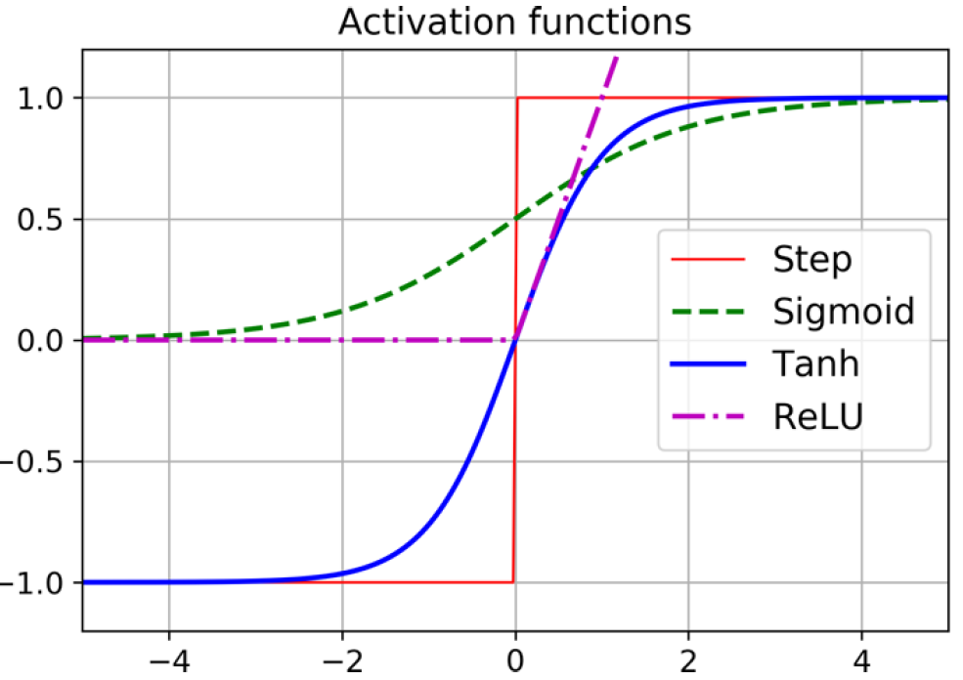
Review
The NN algorithm works well with many activation functions, such as
The logistic function (sigmoid function):
σ(z) = 1 / (1 + exp(–z)).
The hyperbolic tangent function:
tanh(z) = 2σ(2z) – 1.
The Rectified Linear Unit function:
ReLU(z) = max(0, z).

Slide 4
Review
True or False
Support Vector Machines (SVMs) are a type of unsupervised learning model.
Overfitting in machine learning refers to a model that has learned the training data too well, including its noise and outliers, and may perform poorly on unseen data.
The primary goal of a neural network's activation function is to transform the input signal into an output signal for the next layer.
The 'ReLU' (Rectified Linear Unit) activation function returns 0 if its input is negative and returns the input itself if it's positive or zero.
Forward Propagation in neural networks is a method that updates the weights and biases in order to minimize the error of the output layer.

Slide 5
Review
Select the Correct Answer
What does the term 'epoch' refer to in the context of training a machine learning model?
The total number of training examples
One pass through the entire training dataset
The learning rate
The number of layers in a neural network
What does an activation function in a neuron do?
It sums up the inputs to the neuron.
It decides whether a neuron should be activated or not.
It determines the weights of the connections.
It assigns the bias for a neuron.
What is the primary purpose of a cost function in machine learning?
It determines the complexity of a model.
It measures the error or difference between the predicted values and the actual values.
It specifies the architecture of a neural network.
It measures the computational cost of training a model.

Slide 6
Outline
CROSS Validation
Classification Models:
Deep Neural Networks
The Vanishing/Exploding Gradients Problems
Batch Normalization
Faster Optimizer
Convolutional Neural Networks
The Architecture of the Visual Cortex
Convolutional Layers
Filters
Pooling Layers

Slide 7
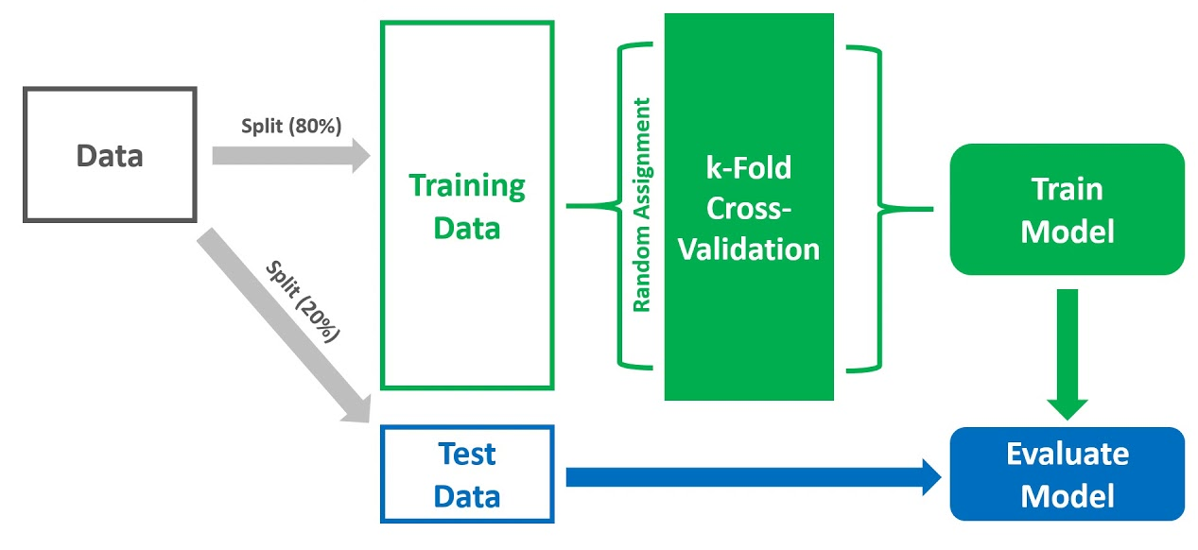
Cross Validation
Cross-Validation (CV) is one of the key topics around testing your learning models.
Provides the ability to estimate model performance on unseen data not used while training.
Why cross-validation?
Testing on unseen data.
Tuning model hyperparameter
The third split is not achievable
Avoid instability of sampling
http://scikit-learn.org/stable/modules/cross_validation.html

Slide 8
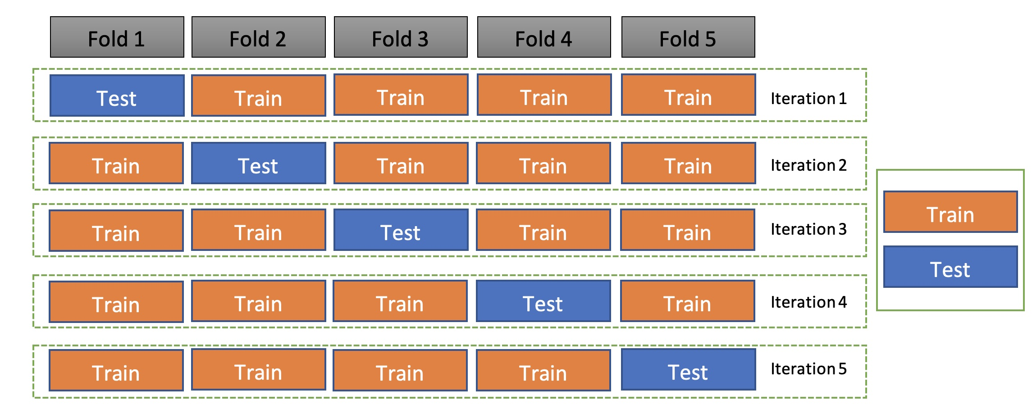
Cross Validation How does it work?
Cross-Validation has two main steps:
Splitting the data into subsets (called folds)
Rotating the training and validation among them.
Each fold has approximately the same size.
Data can be randomly selected in each fold or stratified.
All folds are used to train the model except one, which is used for validation. That validation fold should be rotated until all folds have become a validation fold once and only once.
K-fold and CV are two terms that are used interchangeably.
K-fold is just describing how many folds you want to split your dataset into.
Many libraries use k=10 as a default value representing 90% going to training and 10% going to the validation set.

Slide 9
Cross Validation Example
Possum Dataset
import pandas as pd
# read the csv file from a location you have copied the file
df = pd.read_csv("possum.csv")
#clean up and remove any rows with missing data with
df = df.dropna()
#remove the unnecessary columns, then store the features and the label data in separate variables
X = df.drop(["case", "site", "Pop", "sex"], axis=1)
y = df["sex"]
y=y.replace('m',1)
y=y.replace('f',2)
X = X.astype('int64')
from sklearn.model_selection import train_test_split
X_train, X_val_and_test, y_train, y_val_and_test = train_test_split(X, y, test_size=0.4, random_state=42)
X_valid, X_test, y_valid, y_test = train_test_split(X_val_and_test, y_val_and_test, test_size=0.5)
print(X.shape, y.shape)
from sklearn.model_selection import StratifiedKFold
# define 10-fold cross validation test harness
kfold = StratifiedKFold(n_splits=10, shuffle=True, random_state=42)
cvscores = []
for train, test in kfold.split(X, y):
model = keras.models.Sequential([
keras.layers.Flatten(input_shape=[10, ]),
keras.layers.Dense(30, activation="relu"),
keras.layers.Dense(10, activation="relu"),
keras.layers.Dense(1, activation="sigmoid")
])
# compile the keras model
model.compile(loss='binary_crossentropy', optimizer='adam', metrics=['accuracy'])
# Fit the model
model.fit(X.iloc[train], y.iloc[train], epochs=150, batch_size=10, verbose=0)
# evaluate the model
scores = model.evaluate(X.iloc[test], y.iloc[test], verbose=0)
print("%s: %.2f%%" % (model.metrics_names[1], scores[1]*100))
cvscores.append(scores[1] * 100)
print("%.2f%% (+/- %.2f%%)" % (numpy.mean(cvscores), numpy.std(cvscores)))

Slide 10
Deep Neural Networks
When an NN contains a deep stack of hidden layers, it is called a deep neural network (DNN).
The field of Deep Learning studies DNNs, and more generally models containing deep stacks of computations.
In last session we introduced neural networks and trained our first deep neural networks.
But they were shallow nets, with just a few hidden layers.
What if you need to tackle a complex problem, such as detecting hundreds of types of objects in high-resolution images?
You may need to train a much deeper DNN, perhaps with 10 layers or many more, each containing hundreds of neurons, linked by hundreds of thousands of connections.
Training a deep DNN isn’t a walk in the park.
Welcome to Deep Learning!

Slide 11
Deep Neural Networks
Here are some of the problems you could run into:
You may be faced with the tricky vanishing gradients problem or the related exploding gradients problem.
This is when the gradients grow smaller and smaller, or larger and larger, when flowing backward through the DNN during training.
Both of these problems make lower layers very hard to train.
You might not have enough training data for such a large network, or it might be too costly to label.
Training may be extremely slow.
A model with millions of parameters would severely risk overfitting the training set, especially if there are not enough training instances or if they are too noisy.

Slide 12
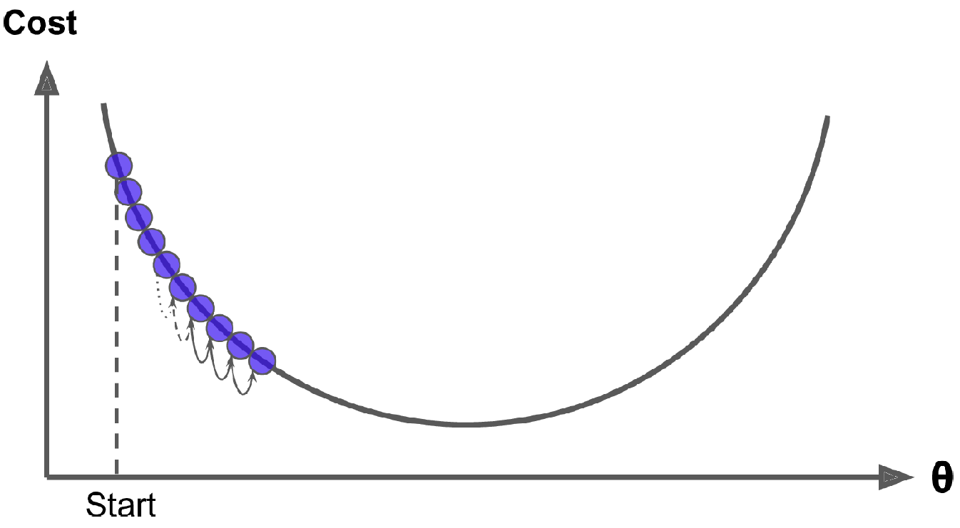
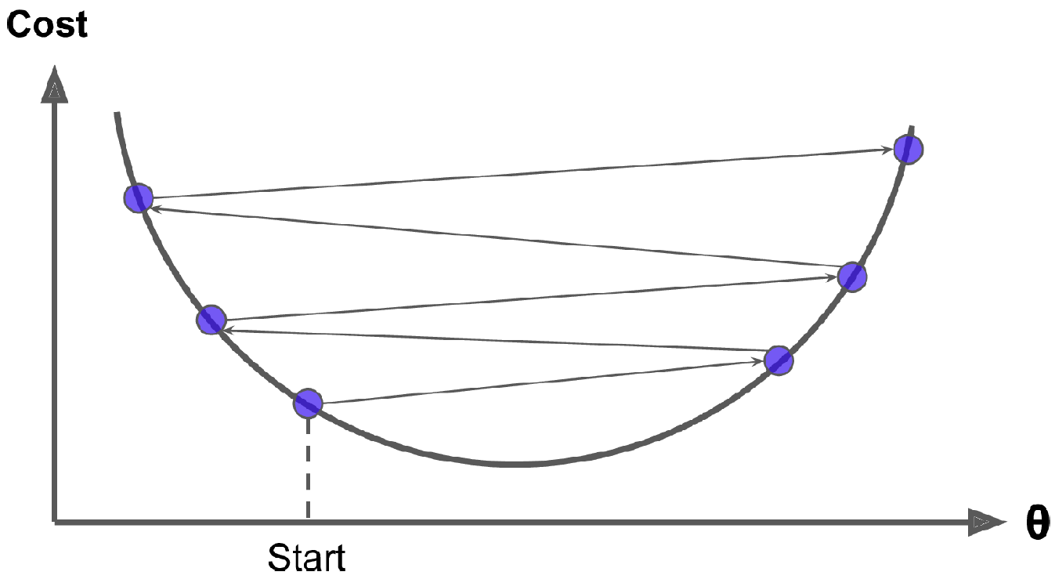
Deep Neural Networks The Vanishing/Exploding Gradients Problems
As we discussed in previous session, the backpropagation algorithm works by going from the output layer to the input layer, propagating the error gradient along the way.
Once the algorithm has computed the gradient of the cost function with regard to each parameter in the network, it uses these gradients to update each parameter with a Gradient Descent step.
Vanishing gradients: Gradients often get smaller and smaller as the algorithm progresses down to the lower layers. As a result, the Gradient Descent update leaves the lower layers’ connection weights virtually unchanged, and training never converges to a good solution.
Exploding gradients: In some cases, the gradients can grow bigger and bigger until layers get insanely large weight updates and the algorithm diverges. (RNN)

Slide 13
Deep Neural Networks The Vanishing/Exploding Gradients Problems
Solutions:
Reducing the amount of Layers: This is the solution could be used in both, scenarios (exploding and vanishing gradient). However..
Weight Initialization: it can significantly alleviate the unstable gradients problem.
Activation Functions: The problems with unstable gradients are in part due to a poor choice of activation function.
Batch Normalization: Adding an operation in the model just before or after the activation function of each hidden layer. This operation simply zero-centers and normalizes each input, then scales and shifts the result.

Slide 14
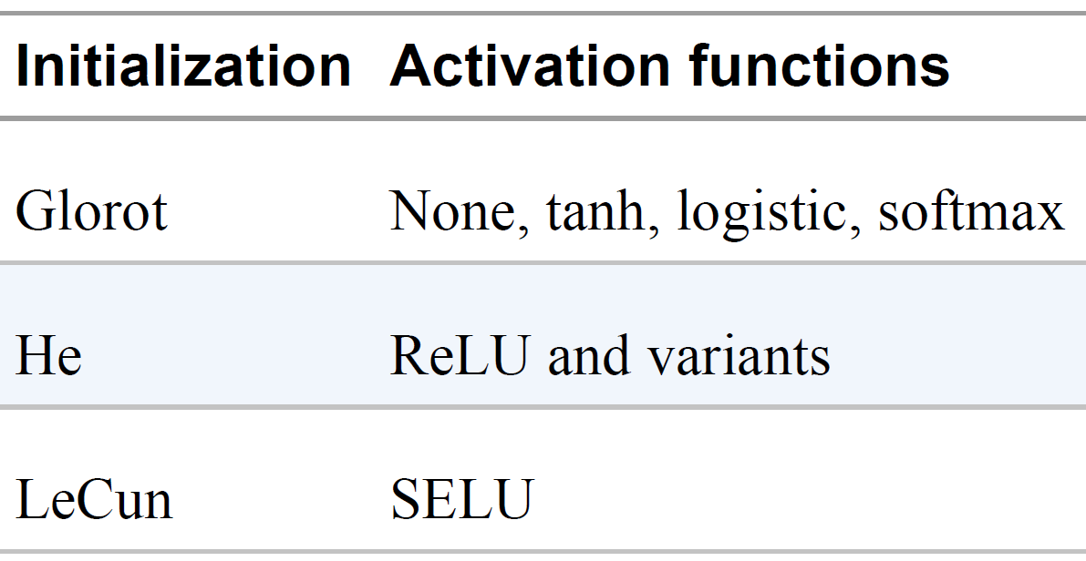
Deep Neural Networks The Vanishing/Exploding Gradients Weight Initialization
We need the signal to flow properly in both directions:
In the forward direction when making predictions, and in the reverse direction when backpropagating gradients. We don’t want the signal to die out, nor do we want it to explode and saturate.
For the signal to flow properly, we need the variance of the outputs of each layer to be equal or close to the variance of its inputs.
By default, Keras uses Glorot initialization with a uniform distribution. When creating a layer, you can change this to He initialization by setting kernel_initializer="he_uniform" or kernel_initializer="he_normal" like this:
Or
keras.layers.Dense(10, activation="relu", kernel_initializer="he_normal")
keras.layers.Dense(10, activation="sigmoid", kernel_initializer="he_normal")
Initialization parameters for each type of activation function

Slide 15
Deep Neural Networks The Vanishing/Exploding Gradients Activation Functions
Traditionally, two widely used nonlinear activation functions are the sigmoid and hyperbolic tangent.
Until recently, most developers had assumed that if Mother Nature had chosen to use roughly sigmoid activation functions in biological neurons, they must be an excellent choice.
A general problem with both the sigmoid and tanh functions is that they saturate. This means that large values snap to 1.0 and small values snap to -1 or 0 for tanh and sigmoid respectively.
The functions are only really sensitive to changes around their mid-point of their input, such as 0.5 for sigmoid and 0.0 for tanh.
But it turns out that other activation functions behave much better in deep neural networks
—in particular, the ReLU activation function, mostly because it does not saturate for positive values (and because it is fast to compute)
The ReLU activation function is not perfect. It suffers from a problem known as the dying ReLUs: during training, some neurons effectively “die,” meaning they stop outputting anything other than 0.
Therefore, to solve this problem, other variants of the ReLU function can be used.

Slide 16
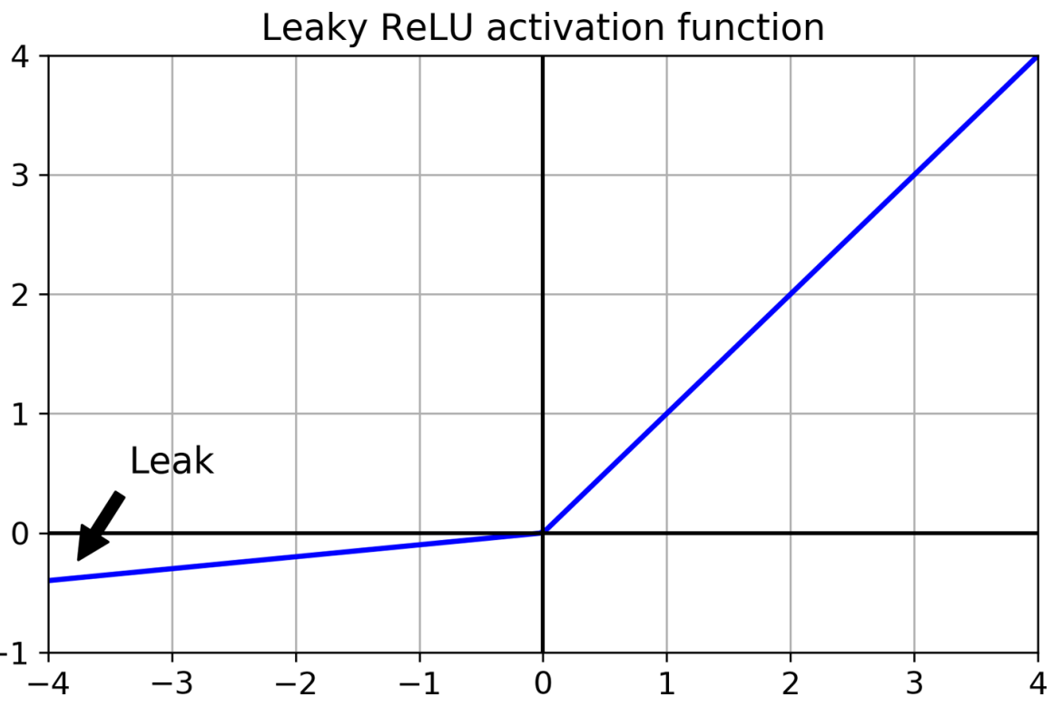
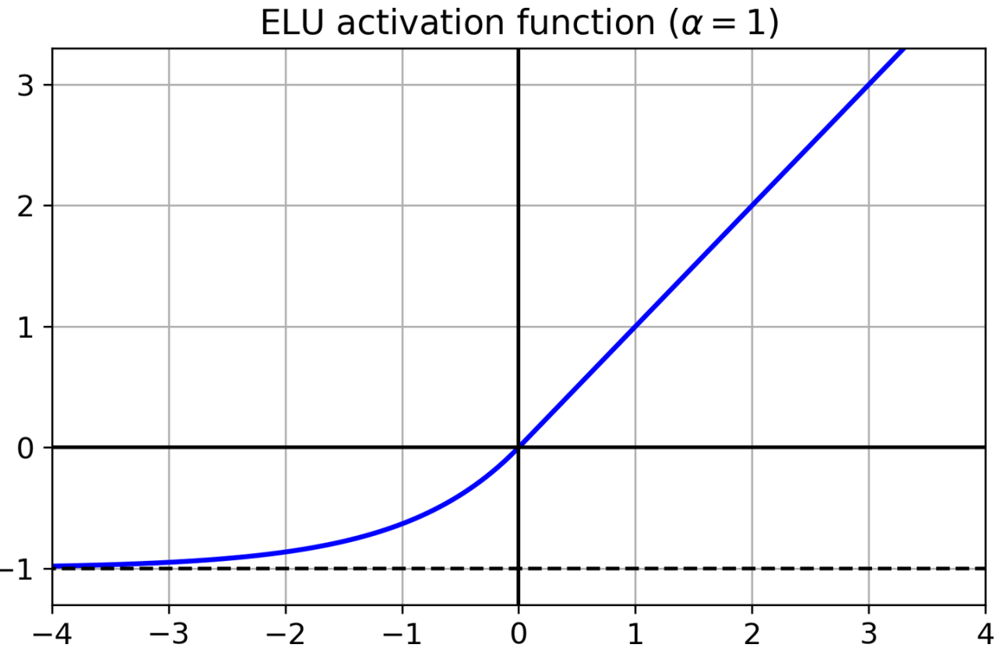
Deep Neural Networks The Vanishing/Exploding Gradients Alternative Activation Functions
Some of the Variations to ReLU activation function:
The ELU (exponential linear unit) and Scaled ELU (SELU)
Leaky ReLU and parametric leaky ReLU (PReLU)
Leaky ReLU Keras implementation:
Leaky ReLU Keras implementation:
model = keras.models.Sequential([
[...]
keras.layers.Dense(10, kernel_initializer="he_normal"), keras.layers.LeakyReLU(alpha=0.2),
[...]
])
layer = keras.layers.Dense(10, activation="selu", kernel_initializer="lecun_normal")

Slide 17
Deep Neural Networks The Vanishing/Exploding Gradients Batch Normalization
Although using He initialization along with ELU (or any variant of ReLU) can significantly reduce the danger of the vanishing/exploding gradients problems at the beginning of training, it doesn’t guarantee that they won’t come back during training.
Batch Normalization (BN) can address these problems.
The technique consists of adding an operation in the model just before or after the activation function of each hidden layer.
This operation zero-centers and normalizes each input, then scales and shifts the result using two new parameter vectors per layer: one for scaling, the other for shifting.
The operation lets the model learn the optimal scale and mean of each of the layer’s inputs.
In many cases, if you add a BN layer as the very first layer of your neural network, you do not need to standardize your training set (e.g., using a StandardScaler);

Slide 18
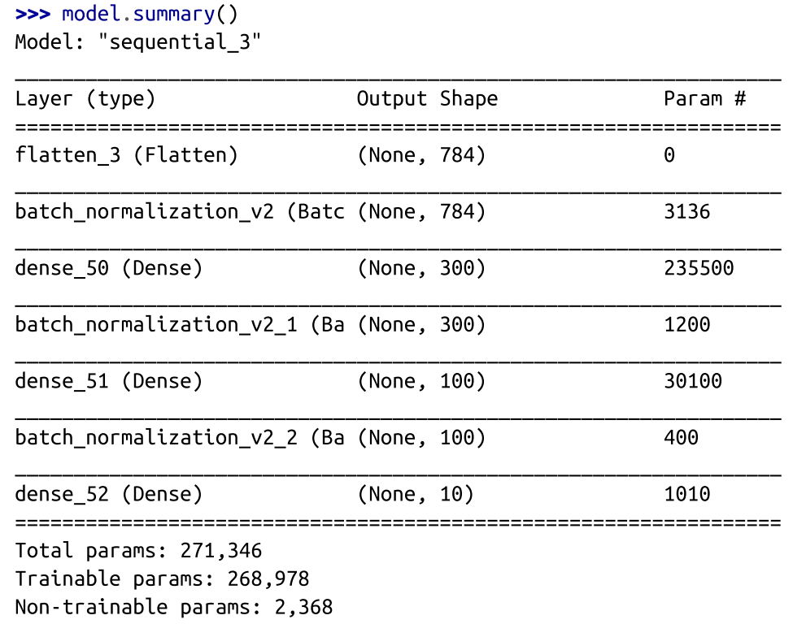
Deep Neural Networks The Vanishing/Exploding Gradients Batch Normalization
Implementing Batch Normalization with Keras:
As with most things with Keras, implementing Batch Normalization is simple and intuitive. Just add a BatchNormalization layer before or after each hidden layer’s activation function, and optionally add a BN layer as well as the first layer in your model.
model = keras.models.Sequential([
keras.layers.Flatten(input_shape=[28, 28]),
keras.layers.BatchNormalization(),
keras.layers.Dense(300, activation="relu"),
keras.layers.BatchNormalization(),
keras.layers.Dense(100, activation="relu"),
keras.layers.BatchNormalization(),
keras.layers.Dense(10, activation="softmax")
])

Slide 19
Deep Neural Networks Faster Optimizer
Training a very large deep neural network can be painfully slow.
So far we have seen a few ways to speed up training (and reach a better solution):
Applying a good initialization strategy for the connection weights, using a good activation function and using Batch Normalization.
Another huge speed boost comes from using a faster optimizer than the regular Gradient Descent optimizer.
The most popular algorithms:
Momentum optimization, Nesterov Accelerated Gradient, AdaGrad, RMSProp, and finally Adam and Nadam optimization.

Slide 20
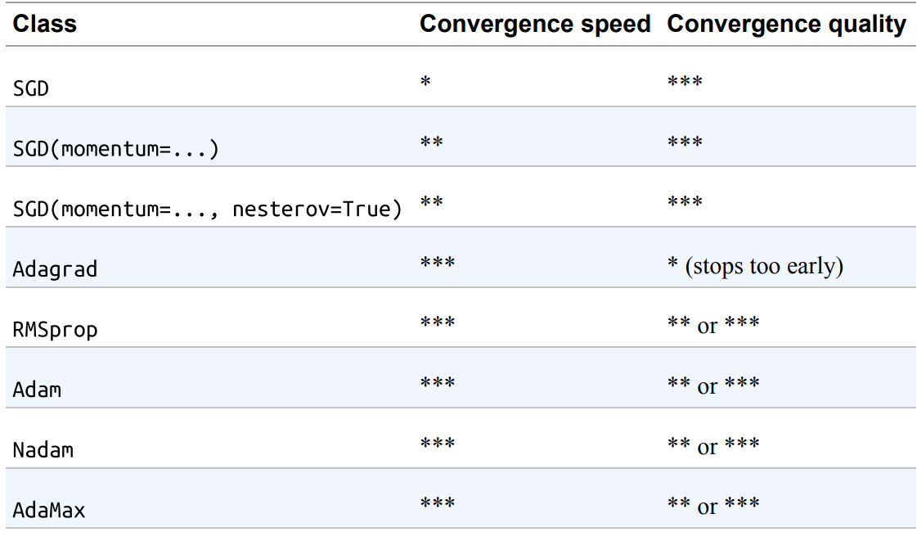
Deep Neural Networks Faster Optimizer
Optimizers Comparison:
Keras Implementation:
optimizer = keras.optimizers.SGD(learning_rate=0.001, momentum=0.9)
optimizer = keras.optimizers.SGD(learning_rate=0.001, momentum=0.9, nesterov=True)
optimizer = keras.optimizers.Adagrad(learning_rate=0.001)
optimizer = keras.optimizers.RMSprop(learning_rate=0.001, rho=0.9)
optimizer = keras.optimizers.Adam(learning_rate=0.001, beta_1=0.9, beta_2=0.999)
optimizer = keras.optimizers.Nadam(learning_rate=0.001, beta_1=0.9, beta_2=0.999)
optimizer = keras.optimizers.Adamax(learning_rate=0.001, beta_1=0.9, beta_2=0.999)

Slide 21
DNN in Python
Let’s Implement DNN in Python

Slide 22
DNN in Python
Building an Image Classifier Using DNN for Fashion MNIST.
Let's start by loading the fashion MNIST dataset.
Choose 5000 samples from the training set as your validation set, then scale the input features in range of 0 to 1.
import tensorflow as tf
from tensorflow import keras
fashion_mnist = keras.datasets.fashion_mnist
(X_train_full, y_train_full), (X_test, y_test) = fashion_mnist.load_data()
X_valid, X_train = X_train_full[:5000] / 255., X_train_full[5000:] / 255.
y_valid, y_train = y_train_full[:5000], y_train_full[5000:]
X_test = X_test / 255.

Slide 23
DNN in Python
Build a DNN with 6 hidden layers of 100 neurons each.
Use He initialization, the ELU activation function and batch normalization,
model = keras.models.Sequential()
#Input Layer
model.add(keras.layers.Flatten(input_shape=[28, 28]))
#hidden1
model.add(keras.layers.BatchNormalization())
model.add(keras.layers.Dense(100, activation="elu", kernel_initializer="he_normal"))
#hidden2
model.add(keras.layers.BatchNormalization())
model.add(keras.layers.Dense(100, activation="elu", kernel_initializer="he_normal"))
#hidden3
model.add(keras.layers.BatchNormalization())
model.add(keras.layers.Dense(100, activation="elu", kernel_initializer="he_normal"))
#hidden4
model.add(keras.layers.BatchNormalization())
model.add(keras.layers.Dense(100, activation="elu", kernel_initializer="he_normal"))
#hidden5
model.add(keras.layers.BatchNormalization())
model.add(keras.layers.Dense(100, activation="elu", kernel_initializer="he_normal"))
#hidden6
model.add(keras.layers.BatchNormalization())
model.add(keras.layers.Dense(100, activation="elu", kernel_initializer="he_normal"))
#output layer
model.add(keras.layers.Dense(10, activation="softmax"))

Slide 24
DNN in Python
Summarise the Model
Compile the model using sparse_categorical_crossentropy, Nadam optimizer and accuracy metric.
Fit the model with the training set. Choose your number of epochs. Add validation set.
model.compile(loss="sparse_categorical_crossentropy",
optimizer="nadam",
metrics=["accuracy"])
history = model.fit(X_train, y_train, epochs=30,
validation_data=(X_valid, y_valid))

Slide 25
DNN in Python
Plot the learning curves:
import pandas as pd
pd.DataFrame(history.history).plot(figsize=(8, 5))
plt.grid(True)
plt.gca().set_ylim(0, 1)
plt.show()

Slide 26
Deep Computer Vision Using Convolutional Neural Networks
Although IBM’s Deep Blue supercomputer beat the chess world champion Garry Kasparov back in 1996, it wasn’t until fairly recently that computers were able to reliably perform seemingly trivial tasks such as detecting a puppy in a picture or recognizing spoken words.
Why are these tasks so effortless to us humans?
The answer lies in the fact that perception largely takes place outside the realm of our consciousness, within specialized visual, auditory, and other sensory modules in our brains.
By the time sensory information reaches our consciousness, it is already adorned with high-level features;
for example, when you look at a picture of a cute puppy, you cannot choose not to see the puppy, not to notice its cuteness. Nor can you explain how you recognize a cute puppy; it’s just obvious to you. Thus, we cannot trust our subjective experience: perception is not trivial at all, and to understand it we must look at how the sensory modules work

Slide 27
Deep Computer Vision Using Convolutional Neural Networks
Convolutional neural networks (CNNs) emerged from the study of the brain’s visual cortex,
They have been used in image recognition since the 1980s.
In the last few decades, thanks to the increase in computational power, the amount of available training data, and the tricks for training deep nets, CNNs have managed to achieve superhuman performance on some complex visual tasks.
They power image search services, self-driving cars, automatic video classification systems, and more.
CNNs are not restricted to visual perception:
They are also successful at many other tasks, such as voice recognition and natural language processing.
We will focus on visual applications for now.

Slide 28
Deep Computer Vision Using Convolutional Neural Networks
In the following slides we will discuss:
Where CNNs came from
What their building blocks look like,
How to implement CNN using TensorFlow and Keras.

Slide 29
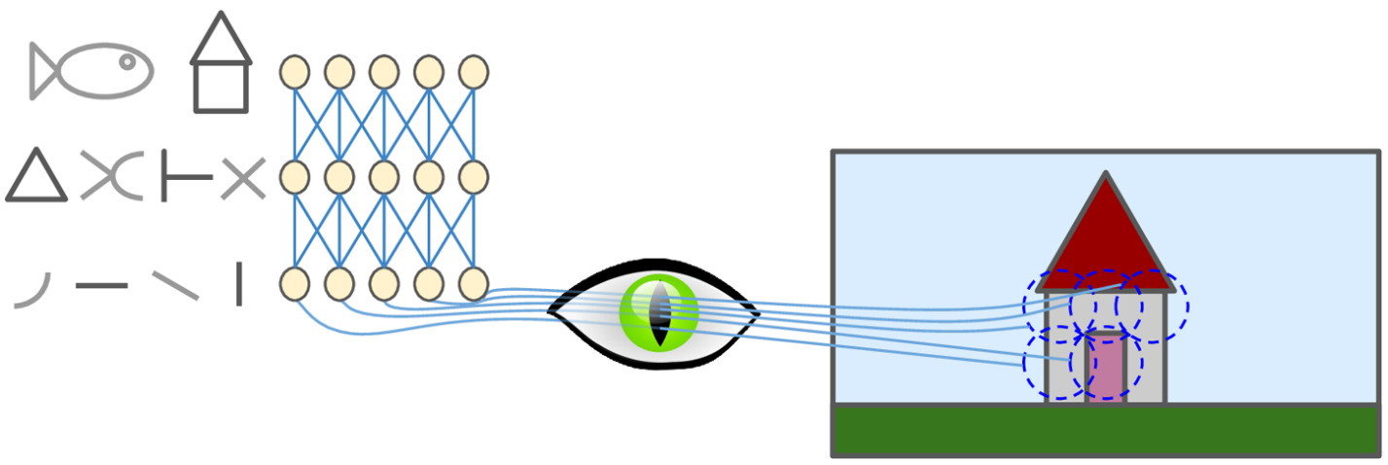
Deep Computer Vision Using CNN The Architecture of the Visual Cortex
David H. Hubel and Torsten Wiesel performed a series of experiments on cats in 1958 and 1959 (and a few years later on monkeys ), giving crucial insights into the structure of the visual cortex.
They showed that many neurons in the visual cortex have a small local receptive field, meaning they react only to visual stimuli located in a limited region of the visual field.
The receptive fields of different neurons may overlap, and together they tile the whole visual field.

Slide 30
Deep Computer Vision Using CNN The Architecture of the Visual Cortex
Some neurons react only to images of horizontal lines, while others react only to lines with different orientations (two neurons may have the same receptive field but react to different line orientations).
Some neurons have larger receptive fields, and they react to more complex patterns that are combinations of the lower-level patterns.
These observations led to the idea that the higher-level neurons are based on the outputs of neighboring lower-level neurons.
This powerful architecture is able to detect all sorts of complex patterns in any area of the visual field.

Slide 31
Deep Computer Vision Using CNN The Architecture of the Visual Cortex
These studies of the visual cortex inspired the neocognitron, introduced in 1980, which gradually evolved into what we now call convolutional neural networks.
An important milestone was a 1998 paper by Yann LeCun et al. that introduced the famous LeNet-5 architecture, widely used by banks to recognize handwritten check numbers.
This architecture has some building blocks that you already know, such as fully connected layers and sigmoid activation functions,
It also introduces two new building blocks:
Convolutional layers
Pooling layers.

Slide 32
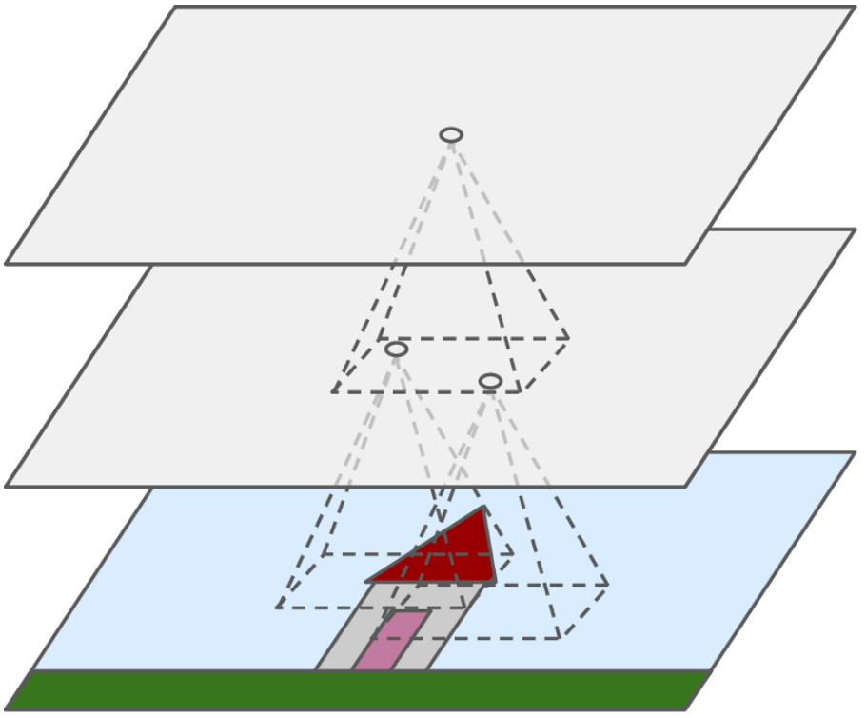
Deep Computer Vision Using CNN Convolutional Layers
The most important building block of a CNN is the convolutional layer:
Neurons in the first convolutional layer are not connected to every single in the input image but only to pixels in their receptive fields.
Each neuron in the second convolutional layer is connected only to neurons located within a small rectangle in the first layer.
This architecture allows the network to concentrate on small low-level features in the first hidden layer.
Then assemble them into larger higher-level features in the next hidden layer, and so on.
This hierarchical structure is common in real-world images, which is one of the reasons why CNNs work so well for image recognition.
Convolutional Layer 2
Convolutional Layer 1
Input Layer

Slide 33
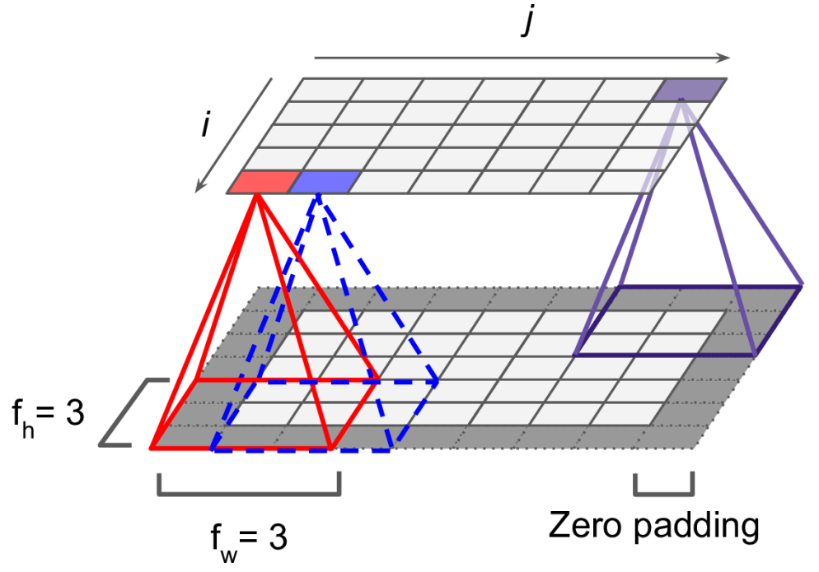
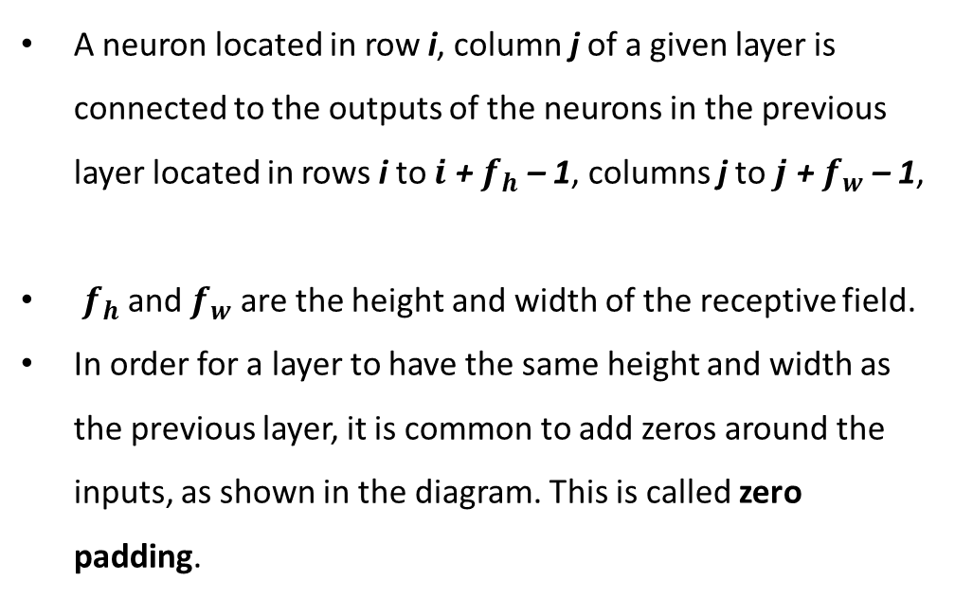
Deep Computer Vision Using CNN Convolutional Layers
A neuron located in row i, column j of a given layer is connected to the outputs of the neurons in the previous layer located in rows i to $i$ + $f_{h}$ – 1, columns j to $j$ + $f_{w}$ – 1,
$f_{h}$ and $f_{w}$ are the height and width of the receptive field.
In order for a layer to have the same height and width as the previous layer, it is common to add zeros around the inputs, as shown in the diagram. This is called zero padding.

Slide 34
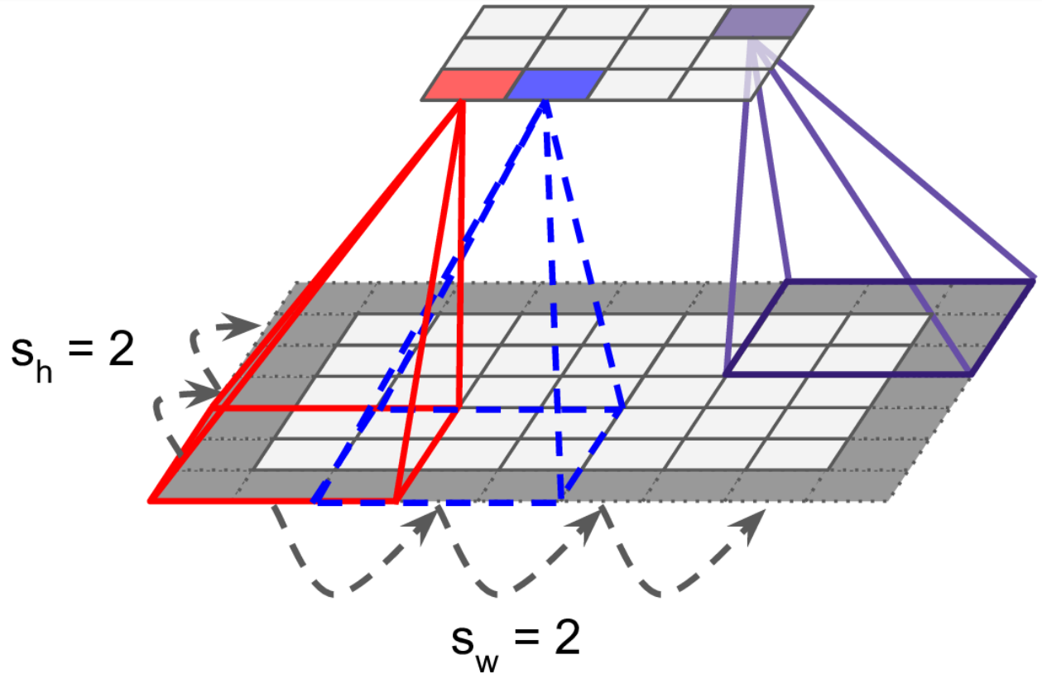
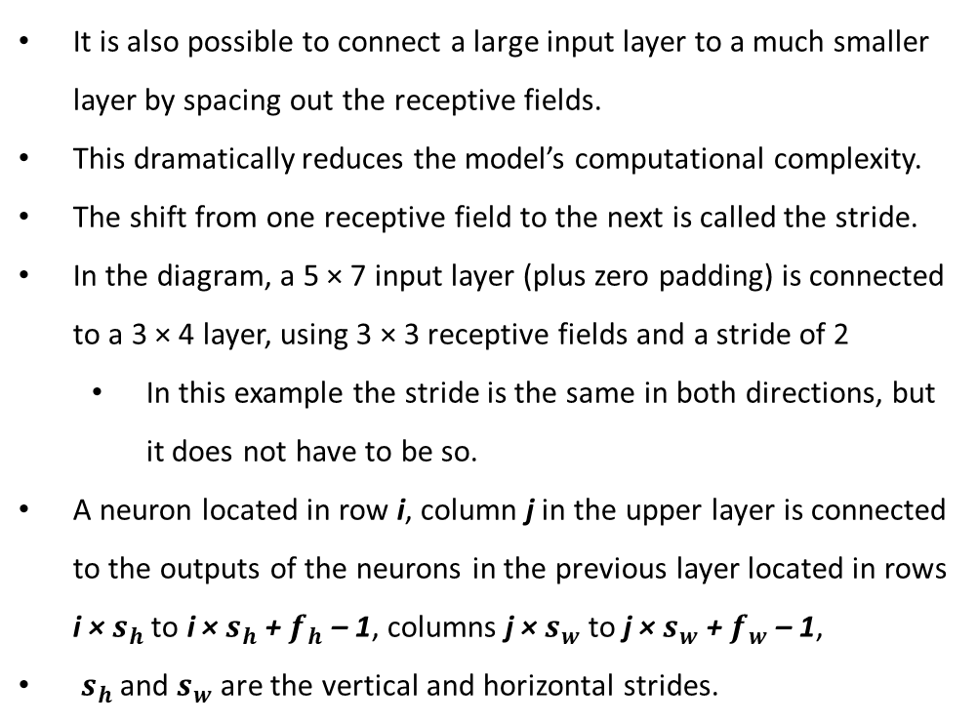
Deep Computer Vision Using CNN Convolutional Layers
It is also possible to connect a large input layer to a much smaller layer by spacing out the receptive fields.
This dramatically reduces the model’s computational complexity.
The shift from one receptive field to the next is called the stride.
In the diagram, a 5 × 7 input layer (plus zero padding) is connected to a 3 × 4 layer, using 3 × 3 receptive fields and a stride of 2
In this example the stride is the same in both directions, but it does not have to be so.
A neuron located in row i, column j in the upper layer is connected to the outputs of the neurons in the previous layer located in rows i × $s_{h}$ to i × $s_{h}$ + $f_{h}$ – 1, columns j × $s_{w}$ to j × $s_{w}$ + $f_{w}$ – 1,
$s_{h}$ and $s_{w}$ are the vertical and horizontal strides.

Slide 35
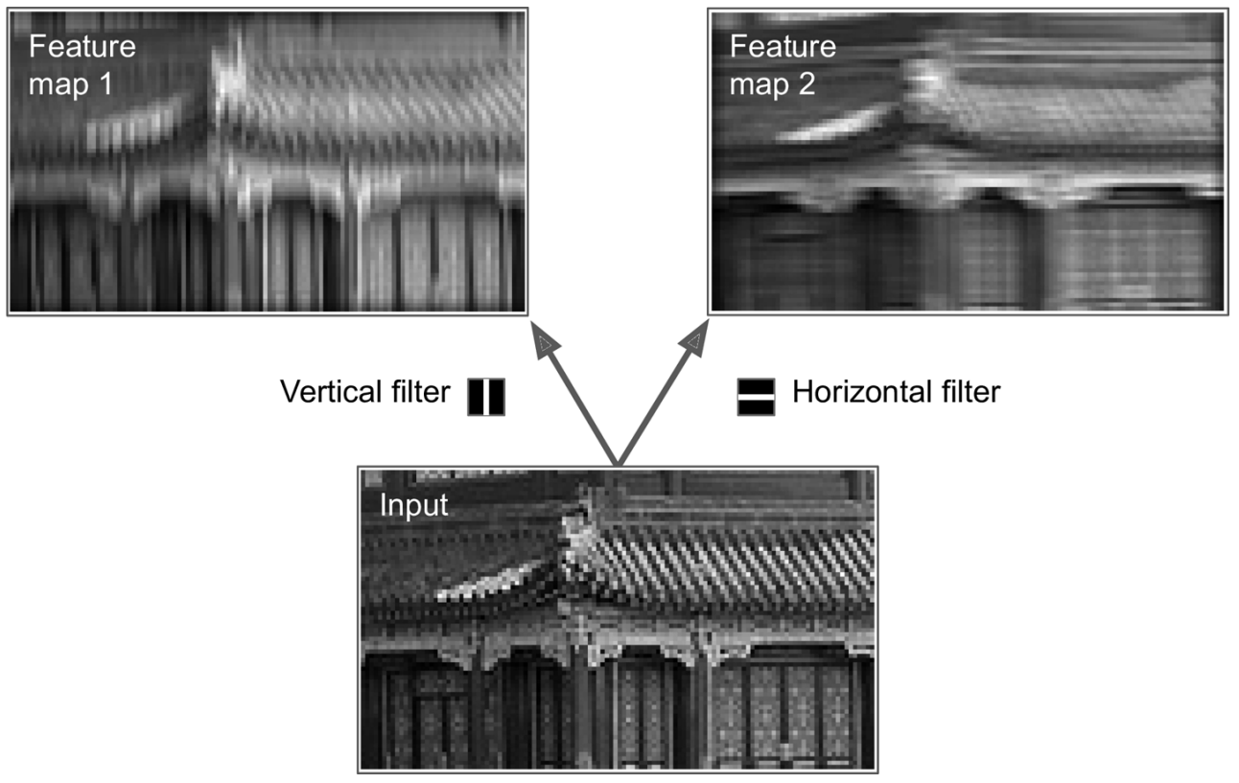
Deep Computer Vision Using CNN Convolutional Layers Filters
A neuron’s weights can be represented as a small image the size of the receptive field.
For example, Figure shows two possible sets of weights, called filters (or convolution kernels).
The first one is represented as a black square with a vertical white line in the middle; neurons using these weights will ignore everything in their receptive field except for the central vertical line.
The second filter is a black square with a horizontal white line in the middle. neurons using these weights will ignore everything in their receptive field except for the central horizontal line.

Slide 36
Deep Computer Vision Using CNN Convolutional Layers Filters
If all neurons in a layer use the same vertical line filter, and you feed the network the input image (the bottom image), the layer will output the top-left image.
The vertical white lines get enhanced while the rest gets blurred.
A layer full of neurons using the same filter outputs a feature map.
Feature Map highlights the areas in an image that activate the filter the most.
Of course, you do not have to define the filters manually: instead, during training the convolutional layer will automatically learn the most useful filters for its task.
The layers above will learn to combine them into more complex patterns.

Slide 37


Deep Computer Vision Using CNN Convolutional Layers Filters

Slide 38
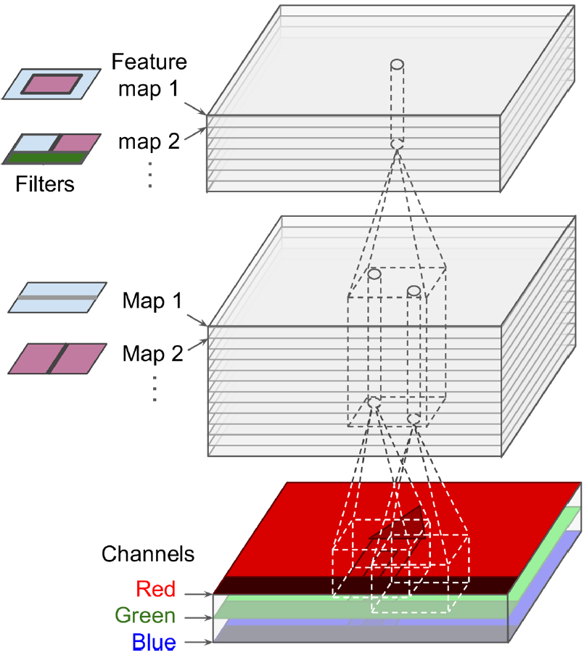
Deep Computer Vision Using CNN Convolutional Layers Stacking Multiple Feature Maps
Up to now, for simplicity, We have represented the output of each convolutional layer as a 2D layer,
In reality a convolutional layer has multiple filters (you decide how many) and outputs one feature map per filter.
So it is more accurately represented in 3D.
A convolutional layer simultaneously applies multiple trainable filters to its inputs, making it capable of detecting multiple features anywhere in its inputs.
Input images are composed of multiple sublayers: one per color channel.
There are typically three: red, green, and blue (RGB).
Grayscale images have just one channel.
Convolutional Layer 2
Convolutional Layer 1
Input Layer

Slide 39
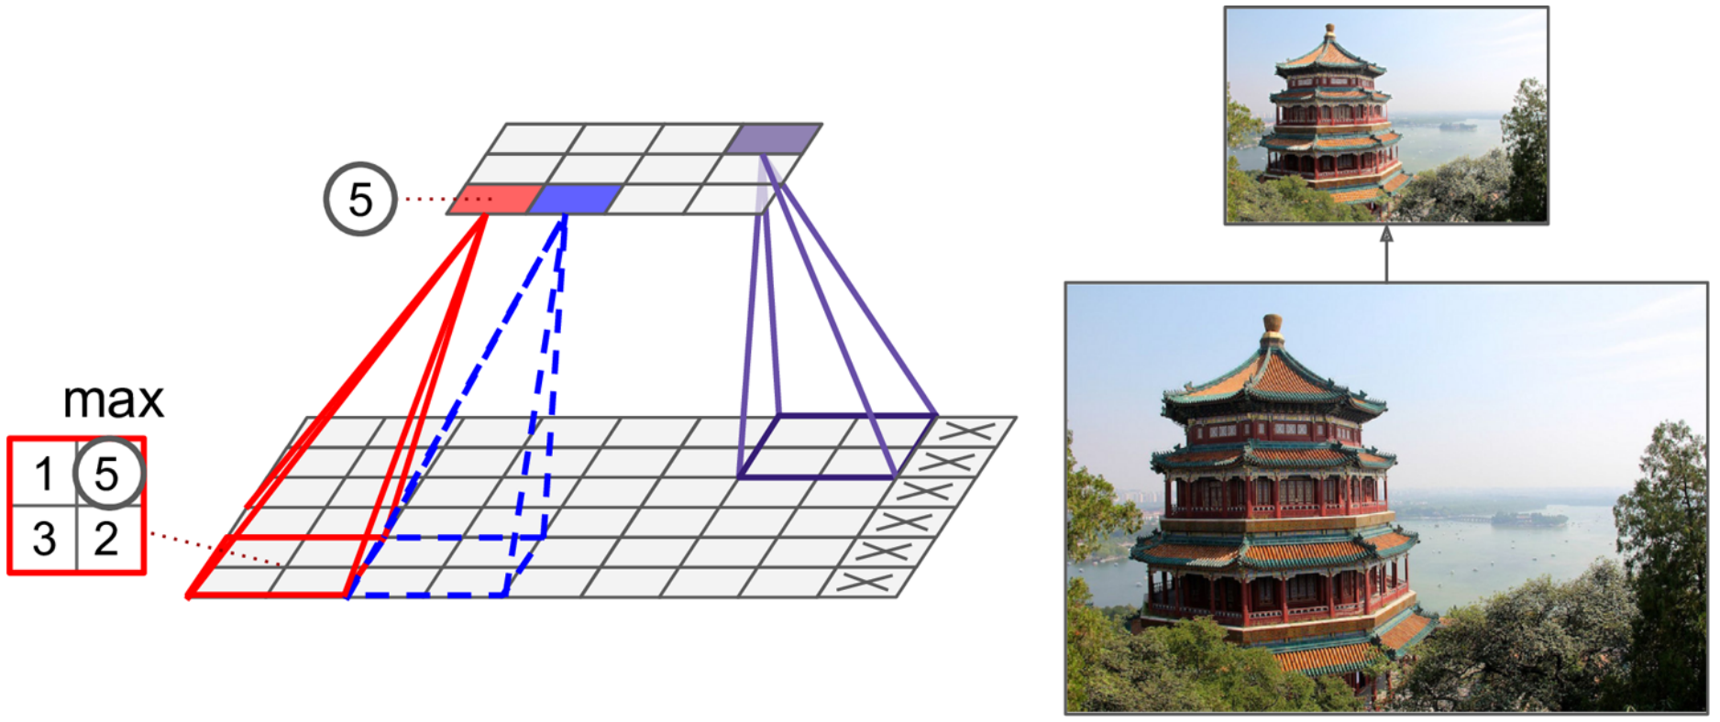
Deep Computer Vision Using CNN Pooling Layers
The pooling layers’ goal is to subsample (i.e., shrink) the input image in order to reduce the computational load, the memory usage, and the number of parameters (thereby limiting the risk of overfitting).
Figure shows a max pooling layer, which is the most common type of pooling layer.
In this example, we use a 2 × 2 pooling kernel, with a stride of 2 and no padding.
Only the max input value in each receptive field makes it to the next layer, while the other inputs are dropped.

Slide 40


Deep Computer Vision Using CNN Pooling Layers
Pooling Layers for Convolutional Neural Networks:
Max Pooling Layer:
Is a pooling operation that calculates the maximum value in each patch of each feature map.
Average Pooling Layer:
Involves calculating the average for each patch of the feature map.
Global Pooling Layers:
Instead of down sampling patches of the input feature map, global pooling down samples the entire feature map to a single value. Global pooling can be used in a model to aggressively summarize the presence of a feature in an image.
Both global average pooling and global max pooling are supported by Keras via the GlobalAveragePooling2D and GlobalMaxPooling2D classes respectively.

Slide 41
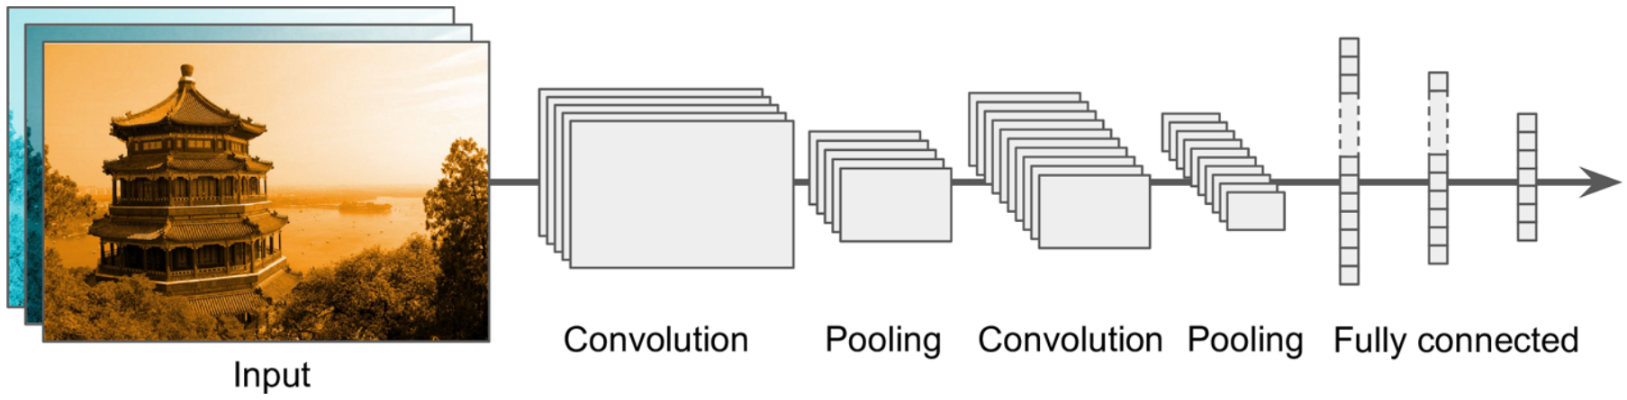
Deep Computer Vision Using CNN CNN Architectures
Typical CNN architectures stack a few convolutional layers (each one generally followed by a ReLU layer), then a pooling layer, then another few convolutional layers (+ReLU), then another pooling layer, and so on.
The image gets smaller and smaller as it progresses through the network, but it also typically gets deeper and deeper (i.e., with more feature maps), thanks to the convolutional layers.
At the top of the stack, a regular feedforward neural network is added, composed of a few fully connected layers (+ReLUs), and the final layer outputs the prediction (e.g., a softmax layer that outputs estimated class probabilities).

Slide 42
CNN in Python
Let’s CNN in Python

Slide 43
CNN in Python
Building an Image Classifier Using CNN for Fashion MNIST.
Let's start by loading the fashion MNIST dataset.
Choose 5000 samples from the training set as your validation set, then scale the input features in range of 0 to 1.
import tensorflow as tf
from tensorflow import keras
fashion_mnist = keras.datasets.fashion_mnist
(X_train_full, y_train_full), (X_test, y_test) = fashion_mnist.load_data()
X_valid, X_train = X_train_full[:5000] / 255., X_train_full[5000:] / 255.
y_valid, y_train = y_train_full[:5000], y_train_full[5000:]
X_test = X_test / 255.

Slide 44
CNN in Python
The problem with the MNIST dataset provides samples that have a shape of (28, 28). With, say, 60.000 samples, the training data Tensor would have a shape of (60000, 28, 28).
Conv2D however expects four dimensions and this throws the error
Reshaping the data, while explicitly adding the channels dimension, resolves the issue.
import tensorflow as tf
from tensorflow import keras
import numpy as np
fashion_mnist = keras.datasets.fashion_mnist
(X_train_full, y_train_full), (X_test, y_test) = fashion_mnist.load_data()
X_valid, X_train = X_train_full[:5000] / 255., X_train_full[5000:] / 255.
y_valid, y_train = y_train_full[:5000], y_train_full[5000:]
X_test = X_test / 255.
X_train = X_train[..., np.newaxis]
X_valid = X_valid[..., np.newaxis]
X_test = X_test[..., np.newaxis]

Slide 45
CNN in Python
Build a CNN
model = keras.models.Sequential([
keras.layers.Conv2D(filters=64, kernel_size=7, strides=(1,1), activation="relu", padding="same", input_shape=[28, 28, 1]),
keras.layers.MaxPooling2D((2,2)),
keras.layers.Conv2D(128, kernel_size=(3,3), activation="relu", padding="same"),
keras.layers.Conv2D(128, 3, activation="relu", padding="same"),
keras.layers.MaxPooling2D(2),
keras.layers.Conv2D(256, 3, activation="relu", padding="same"),
keras.layers.Conv2D(256, 3, activation="relu", padding="same"),
keras.layers.MaxPooling2D(2),
keras.layers.Flatten(),
keras.layers.Dense(128, activation="relu"),
keras.layers.Dropout(0.5),
keras.layers.Dense(64, activation="relu"),
keras.layers.Dropout(0.5),
keras.layers.Dense(10, activation="softmax")
])
https://www.tensorflow.org/api_docs/python/tf/keras/layers/Conv2D

Slide 46
CNN in Python
Summarise the Model
Compile the model using sparse_categorical_crossentropy, Nadam optimizer and accuracy metric.
Fit the model with the training set. Choose your number of epochs. Add validation set.
model.compile(loss="sparse_categorical_crossentropy",
optimizer="nadam",
metrics=["accuracy"])
history = model.fit(X_train, y_train, epochs=5,
validation_data=(X_valid, y_valid))

Slide 47
CNN in Python
Plot the learning curves:
import pandas as pd
pd.DataFrame(history.history).plot(figsize=(8, 5))
plt.grid(True)
plt.gca().set_ylim(0, 1)
plt.show()

Slide 48
Class Activity
Implement a Convolutional Neural Network (CNN) on the CIFAR-10 dataset
Option 1:
Option 2:
# Import necessary libraries
import tensorflow as tf
from tensorflow import keras
# Load CIFAR-10 data
(train_images, train_labels), (test_images, test_labels) = keras.datasets.cifar10.load_data()
# Normalize pixel values to be between 0 and 1
train_images, test_images = train_images / 255.0, test_images / 255.0
# Import necessary libraries
import tensorflow as tf
from tensorflow.keras import datasets, layers, models
# Load CIFAR-10 data
(train_images, train_labels), (test_images, test_labels) = datasets.cifar10.load_data()
# Normalize pixel values to be between 0 and 1
train_images, test_images = train_images / 255.0, test_images / 255.0

Slide 49
Class Activity
Implement a Convolutional Neural Network (CNN) on the CIFAR-10 dataset
Task 1: Implement a Convolutional Neural Network model using the Sequential API in Keras. The network should contain at least one convolutional layer followed by pooling layers, and then fully connected layers. Again, use appropriate activation functions, and add dropout if needed.
Task 2: Compile the model, specifying the optimizer, loss function, and metrics.
Task 3: Train the model using the training data, and validate it using the validation data. You can choose the number of epochs.
Task 4: Evaluate the model on the test data and report the accuracy and loss.

Slide 50
Any Questions?

